Slide 1
REAL TIME OBJECT DETECTION
Team Members:
AJEYA DEY (34200115003)
AMLAN BOSE (34200115004)
ANAMITRA CHOWDHURY (34200115005)
ORIJITA ADHIKARY (34200115032)

Slide 2
Acknowledgement
In performing our assignment, we had to take the help and guideline of some respected persons, who deserve our greatest gratitude. The completion of this assignment gives us much Pleasure. We would like to show our gratitude Mr. PMJ Sir for giving us a good guideline for assignment throughout numerous consultations. We would also like to expand our deepest gratitude to all those who have directly and indirectly guided us in writing this assignment.

Slide 3
CONTENTS
Object Detection
General Object Detection Framework
YOLO: You Only Look Once
YOLO Algorithm
Working of YOLO
Practical Working Example
Comparison of YOLO with other detectors
Advantages and Disadvantages
Future Scope
Conclusion
Bibliography

Slide 4
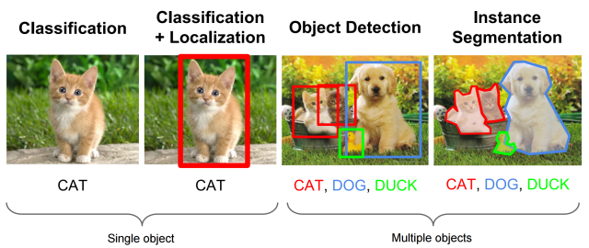
OBJECT DETECTION
Object detection is a computer technology related to computer vision and image processing that deals with detecting instances of semantic objects of a certain class in digital images and videos.
An overview of this is depicted in the picture below:

Slide 5
GENERAL OBJECT DETECTION FRAMEWORK
Prior approaches have proposed pipelines that are separate stages in a sequence. This causes a disconnect between what each stage accomplishes and the final objective, which is drawing a tight bounding box around the objects in an image.
The 3-stage process:
STEP 1: Algorithm generates regions of interest or region proposals. These region proposals are a large set of bounding boxes spanning the full image.
STEP 2: Visual features are extracted for each of the bounding boxes, they are evaluated and it is determined whether and which objects are present in the proposals based on visual features.
STEP 3: Post-processing step, overlapping boxes are combined into a single bounding box.

Slide 6

YOLO (You Only Look Once) is a deep learning based object detection algorithm. It consists in determining the location on the image where certain objects are present., as well as classifying those objects.
Why YOLO?
YOLO uses a single CNN network for both classifying and localising the object using using bounding boxes.
Also, it looks at the whole image at test time so its predictions are informed by global context in the image.

Slide 7
YOLO Algorithm:
The way YOLO works is that it subdivides the image into an NxN grid. Each grid cell, also known as an anchor, represents a classifier which is responsible for generating K bounding boxes around potential objects whose ground truth center falls within that grid cell and classifying it as the correct object.

Slide 8
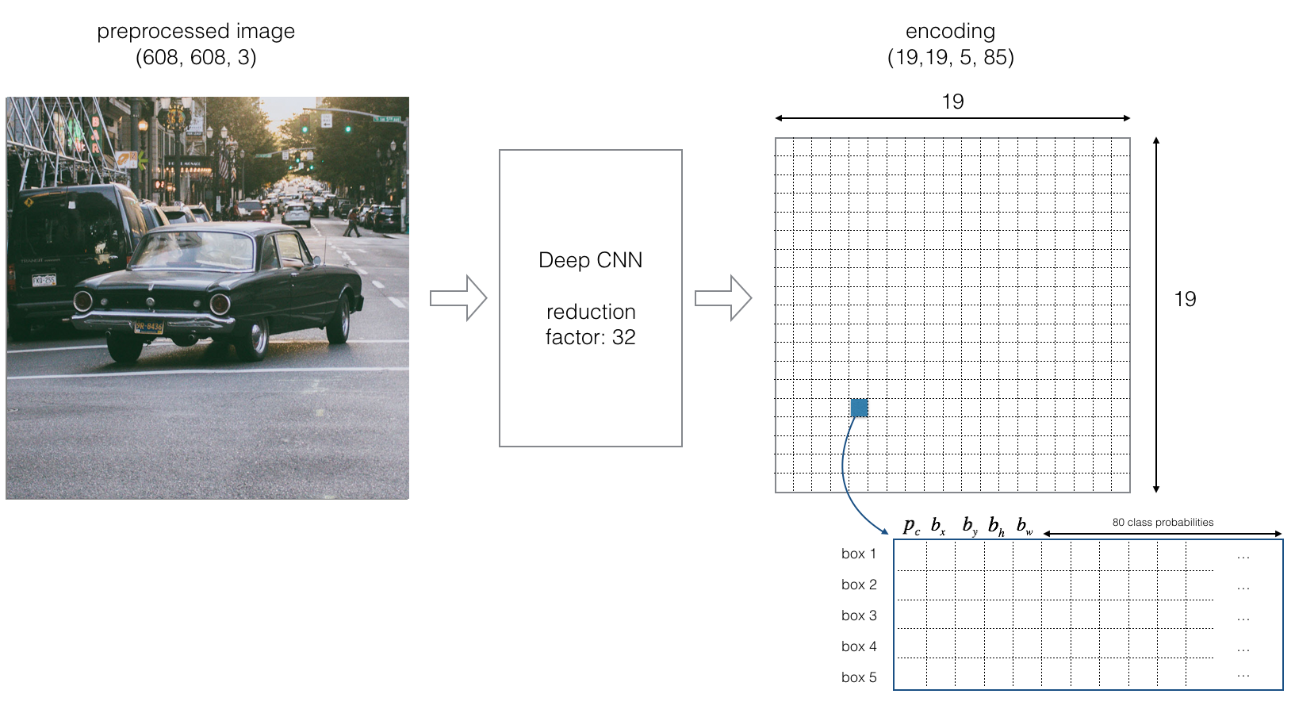
Working: Part I
Splitting the image into cells of 19X19 grid
Each cell will be responsible for predicting 5 bounding boxes.
This will give us 1805 bounding boxes for an image.

Slide 9
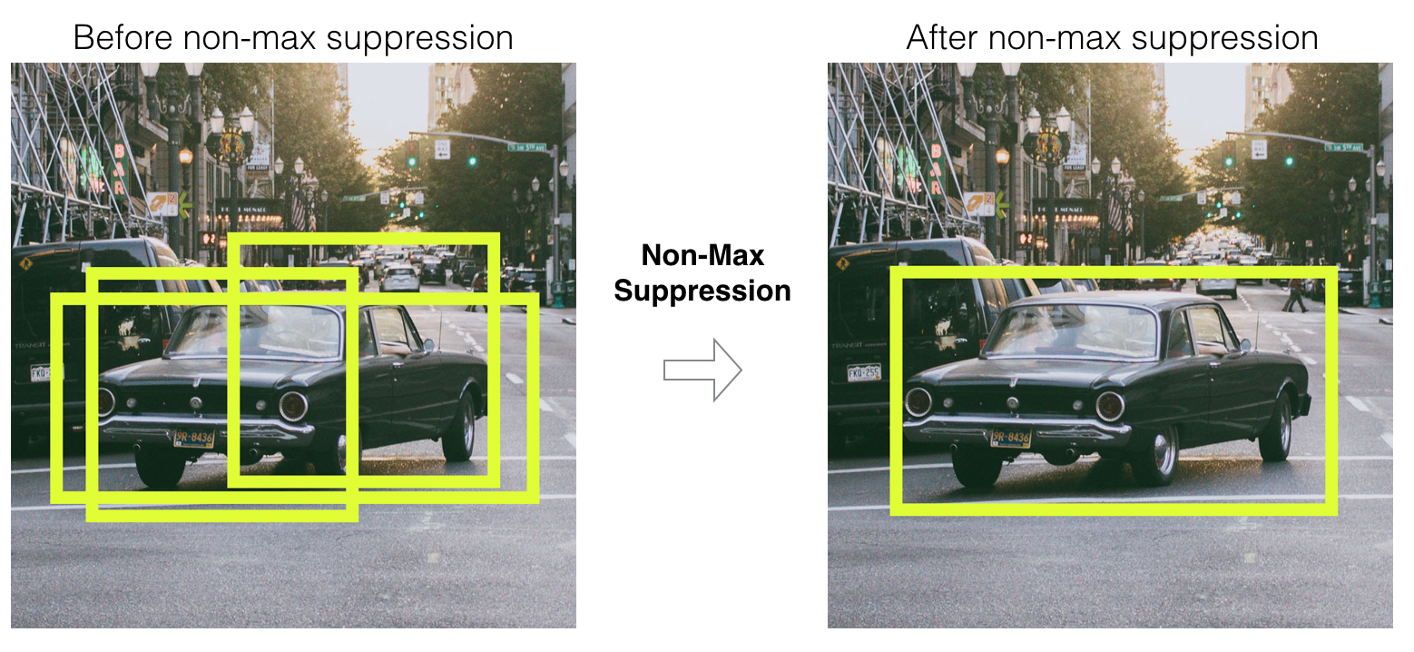
Working: Part II
Majority of those cells and boxes won’t have an object inside and this is the reason why we need to predict pc.
In the next step, we’re removing boxes with low object probability and bounding boxes with the highest shared area in the process called non-max suppression.

Slide 10
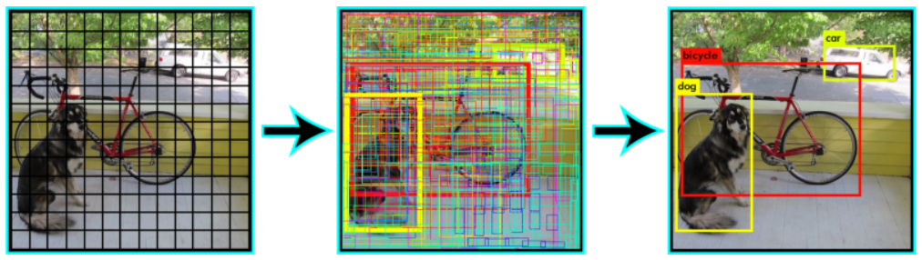
Practical Working Example

Slide 11
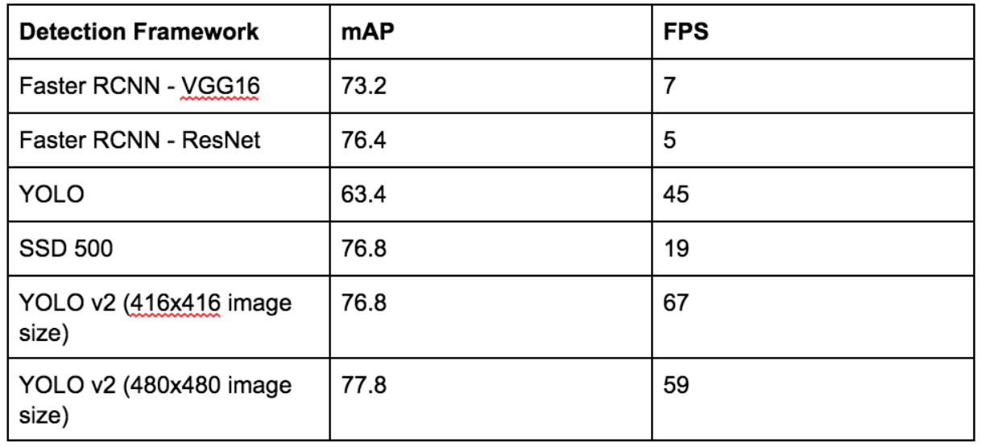
How is YOLO different from other Object detectors?
Comparisons of YOLO to other detection frameworks in the table below:

Slide 12
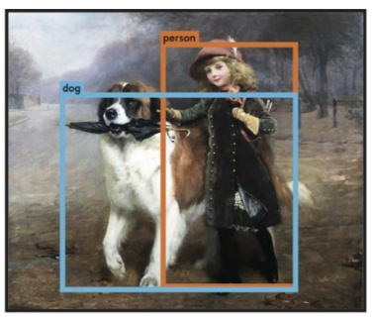
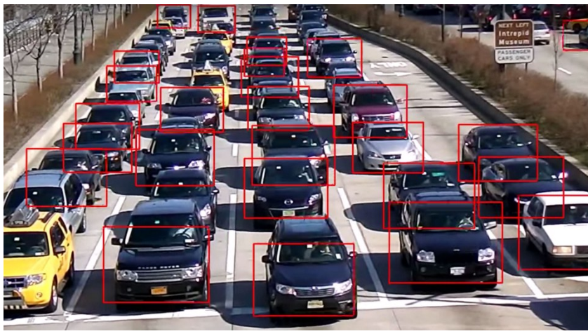
Advantages and Disadvantages
Pros:
Speed (45 frames per second — better than real time)
Network understands generalized object representation (This allowed them to train the network on real world images and predictions on artwork was still fairly accurate).
Faster version (with smaller architecture) — 155 frames per sec but is less accurate.
Cons:
Our model struggles with small objects that appear in groups, such as flocks of birds.
Since our model learns to predict bounding boxes from data, it struggles to generalize to objects in new or unusual aspect ratios or configurations.

Slide 13
Future Scope
In future our project will improve and may help in the following ways:-
Recognize the specific instance (e.g., to identify the subject’s face)
Track the object over an image sequence (e.g., to track the face in a video)
Extracting information (e.g., detecting a piece of text from a book)
Human-computer interaction (HCI)
Security (e.g., recognition, tracking)
Retrieval (e.g., search engines, photo management)

Slide 14
Conclusion
An accurate and efficient object detection system has been developed which achieves comparable metrics with the existing YOLO system. This project uses recent techniques in the field of neural network and deep learning. Custom dataset was created using label image and the evaluation was consistent. This can be used in real time applications which require object detection for pre-processing in their pipeline.

Slide 15
Bibliography
https://pjreddie.com/media/files/papers/yolo.pdf
YOLO — You only look once, real time object detection explained https://towardsdatascience.com/yolo-you-only-look-once-real-time
https://medium.com/@enriqueav/object-detection-with-yolo-implementations-and-how-to-use-them-5da928356035
A Practical Guide to Object Detection using the Popular YOLO https://www.analyticsvidhya.com/blog/2018/12/practical-guide

